Slide 1

.NET MAUI框架
(Multi-platform App UI)

Slide 2

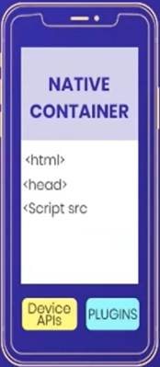
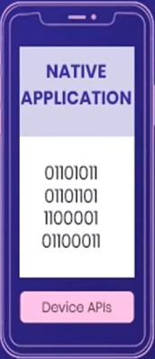
What kind of App Development to Choose?
WEB APP
HYBRID APP
NATIVE APP

Slide 3
Pure Native App
App
Platform
Code
Native
Widgets
Canvas
Events
Location
Bluetooth
Audio
Sensor
Camera
Etc...

Slide 4
Xamarin, Uno Platform & React Native Apps
App
Platform
Code
Bridge
Native
Widgets
Canvas
Events
Location
Bluetooth
Audio
Sensor
Camera
Etc...

Slide 5
Flutter App
App
Platform
Code
Widgets / Rendering
(Skia)
Canvas
Events
Location
Bluetooth
Events
Channel
Audio
Sensor
Camera
Etc...
Microsoft.Maui.Graphics.Controls - 实验性的跨平台绘制控件

Slide 6
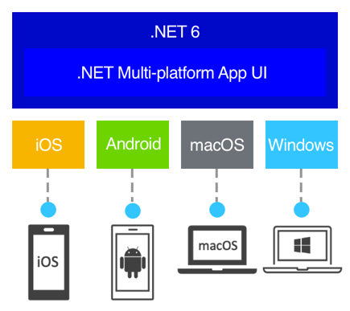
.NET MAUI is a cross-platform framework for creating native mobile and desktop apps with C# and XAML

Slide 7
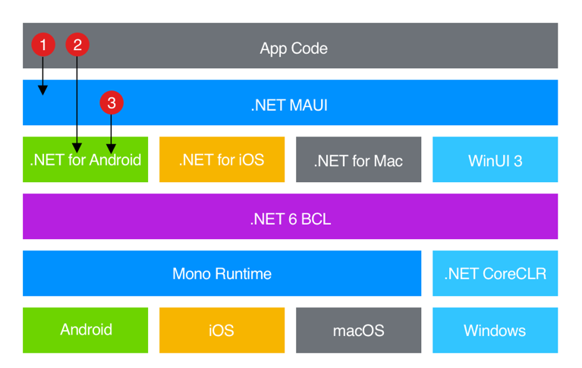
How .NET MAUI works

Slide 8
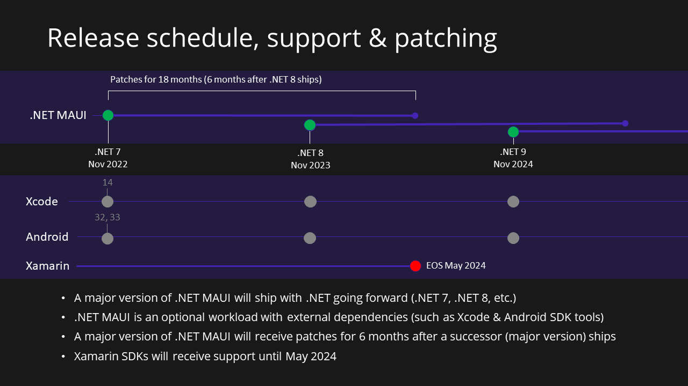
The MAUI Milestone

Slide 9
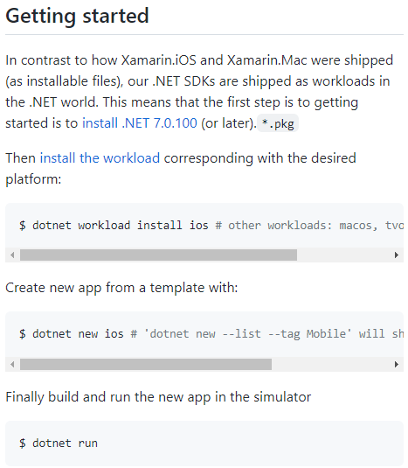
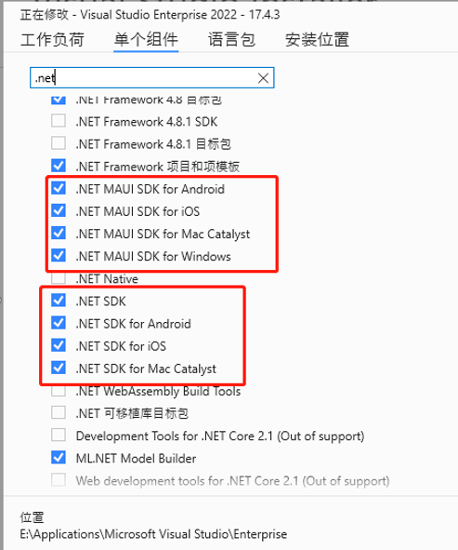
All in .NET world

Slide 10
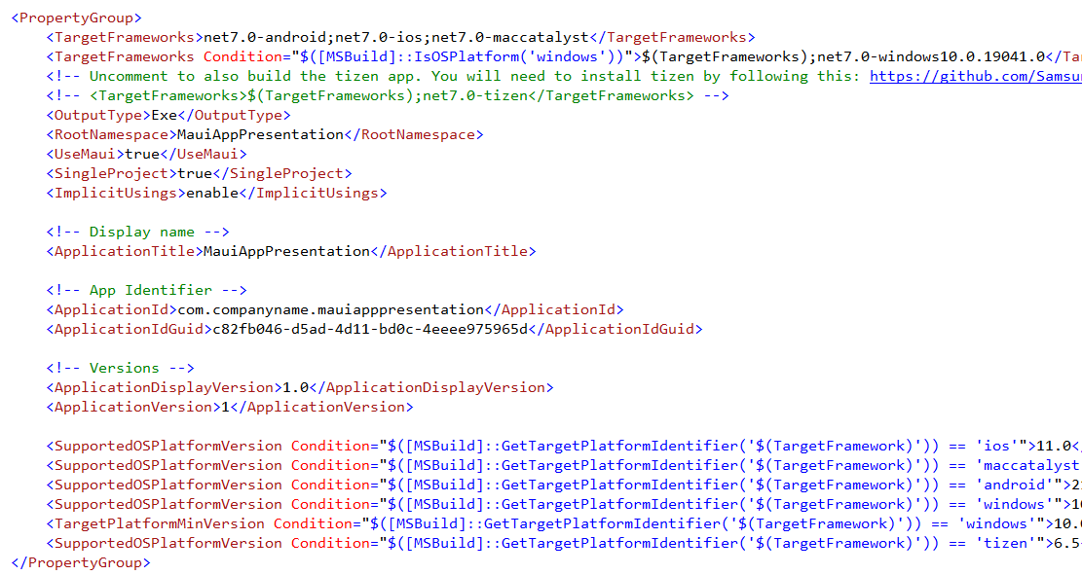
Target Frameworks

Slide 11
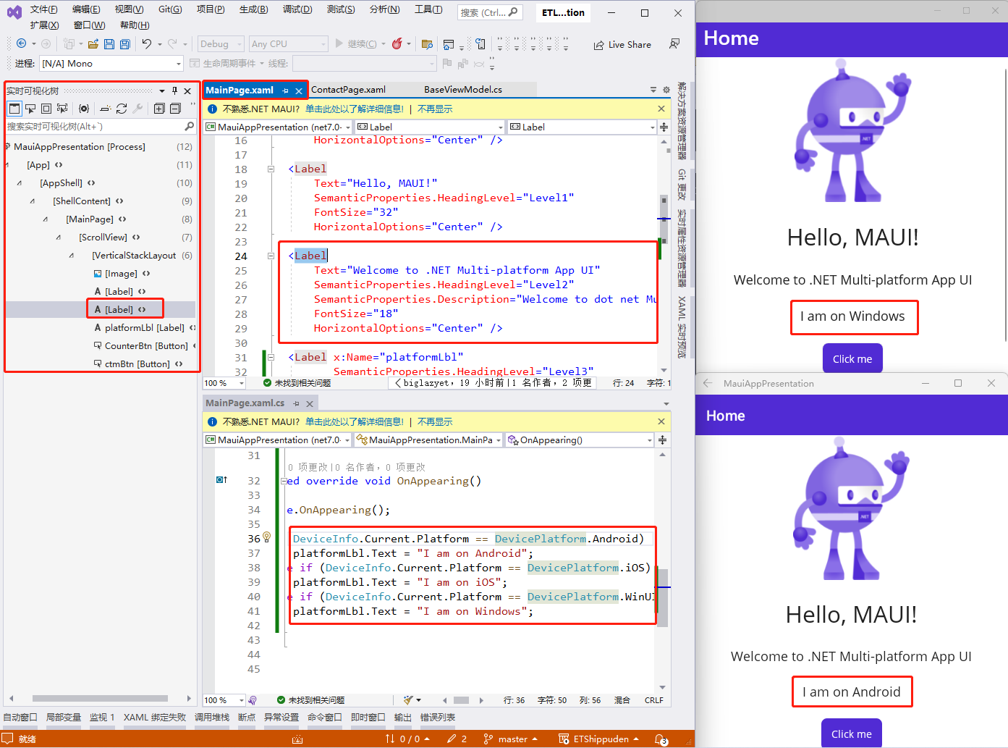
Same code on Different platforms with MAUI

Slide 12
What MAUI Provides
40+ Controls
Cross-platform APIs
Cross-platform graphics
Single Project
MVVM & MVU
Customize handlers to enhance UI
Hot-Reload

Slide 13
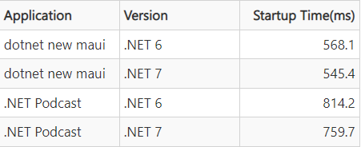
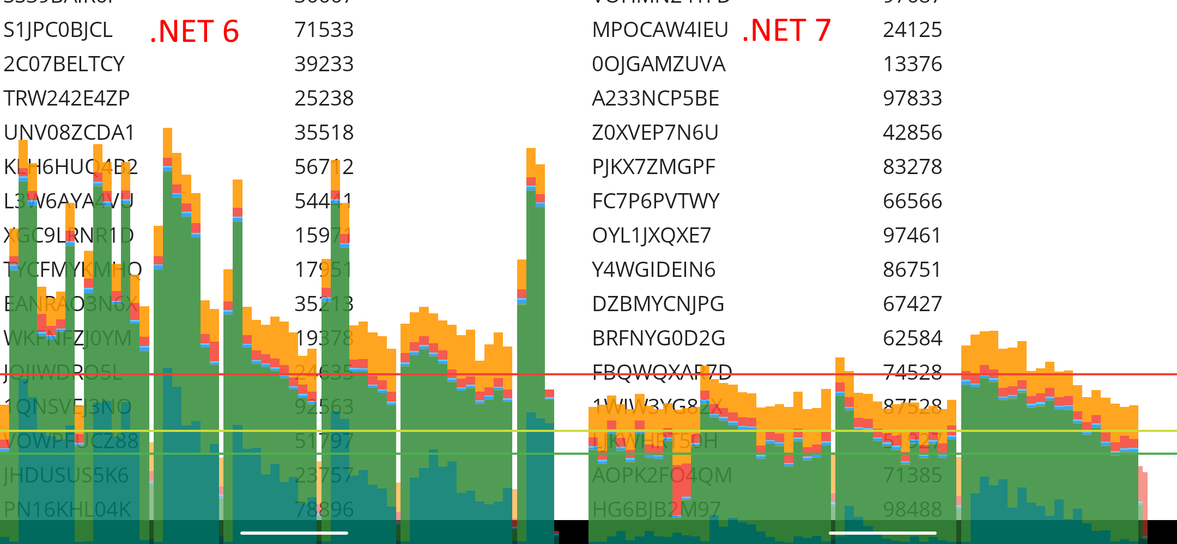
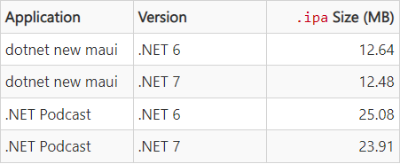
.NET 7 Performance Improvements in .NET MAUI
Faster startup in Android
1000 rows of two data-bound labels with CollectionView in Android
Smaller size in iOS

Slide 14
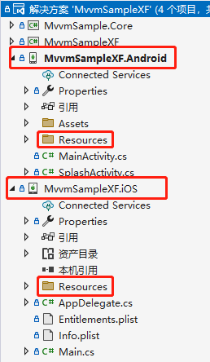
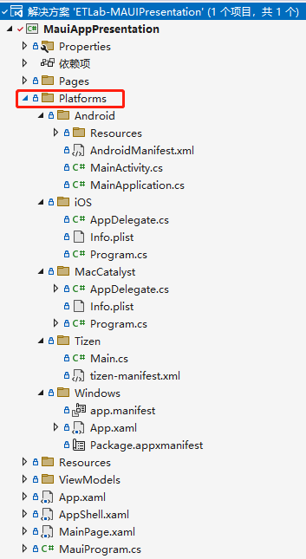
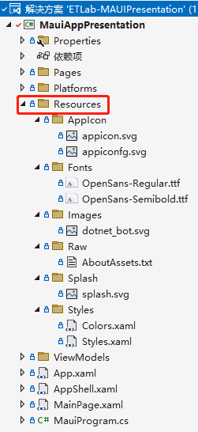
Single Project
Xamarin.Forms
MAUI - Platforms
MAUI - Resources

Slide 15
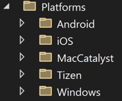
Configure multi-targeting
**/**/*.Android.cs
**/**/*.MaciOS.cs
**/**/*.iOS.cs
**/**/*.MacCatalyst.cs
**/**/*.Windows.cs
**/Android/**/*.cs
**/MaciOS/**/*.cs
**/iOS/**/*.cs
**/MacCatalyst/**/*.cs
**/Windows/**/*.cs
Default
Filename-based
Folder-based

Slide 16
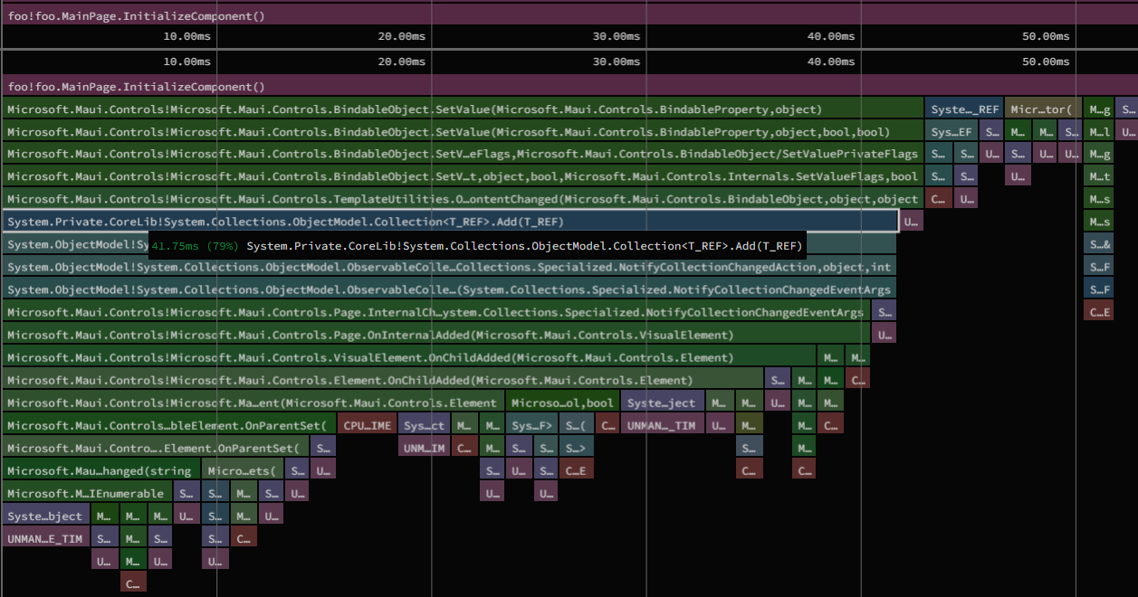
Profiling .NET MAUI Apps
Windows：
perfview
dotnet-trace
adb
Android：
dotnet-dsrouter
dotnet-trace
adb
iOS & Mac：
dotnet-dsrouter
dotnet-trace
mlaunch

Slide 17
Profiling .NET MAUI Apps
Android为例
dotnet-trace
dotnet-counters
(diagnostic tools...)
dotnet-dsrouter
.NET mobile
applications
IPC
TCP/IP

Slide 18
Profiling .NET MAUI Apps
adb reverse tcp:9000 tcp:9001
设置反向端口转发：真机或模拟器上的端口9000转发到主机上的端口9001
adb shell setprop debug.mono.profile '127.0.0.1:9000,suspend'
配置真机或模拟器，以便分析的应用程序挂起，直到跟踪实用程序连接
dotnet-dsrouter client-server -tcps 127.0.0.1:9001 -ipcc /tmp/maui-app --verbose debug
主机上端口9001启动TCP/IP服务端 和 在socket name/path路径上启动IPC客户端
dotnet-trace collect --diagnostic-port /tmp/maui-app --format speedscope
事件流从移动应用经由dotnet-dsrouter流向dotnet-trace nettrace文件
dotnet build -f net7.0-android -t:Run -c Release -p:AndroidEnableProfiler=true
编译并运行应用程序

Slide 19
Far Away from Code-behind
MVVM 核心：数据绑定
行为behaviors：附加属性 或 继承Behavior或Behavior<T>
可绑定属性 & 附加属性
触发器Triggers：属性，数据，事件，状态，自适应，比较状态，设备状态，方向状态触发器
绑定值转换器：Binding Converter
设置样式：XMAL形式 | CSS形式；主题更改
EventToCommand

Slide 20
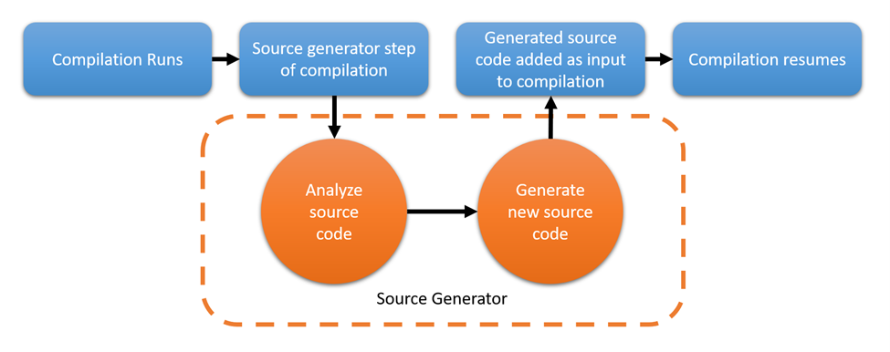
MVVM with Source Generator
CommunityToolkit.Mvvm Package

Slide 21
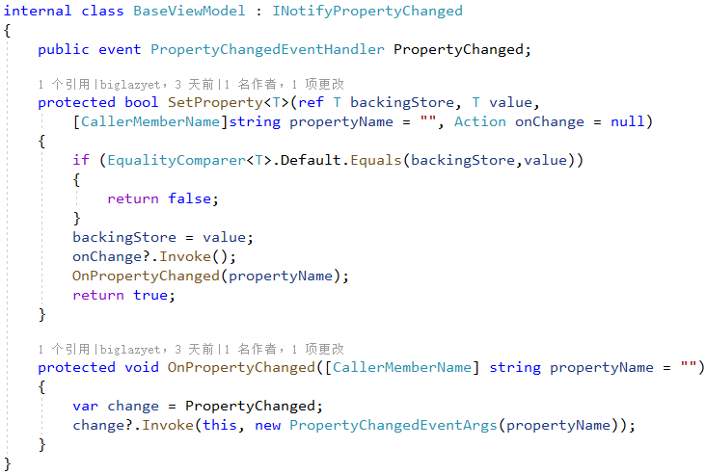
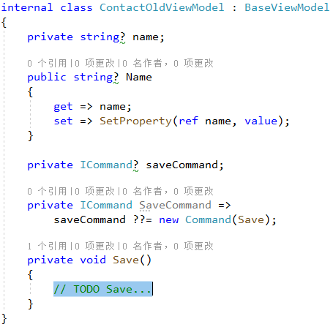
The Old Style

Slide 22
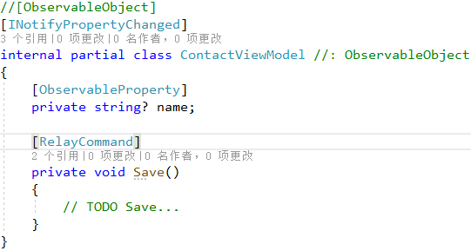
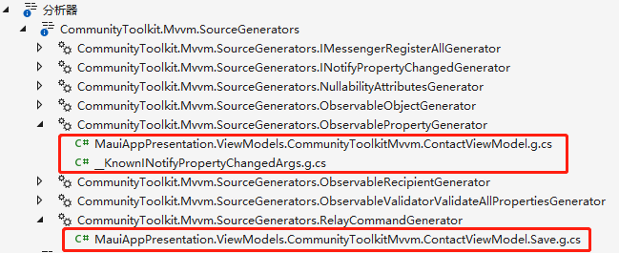
The New Way
Less Code
Better Performance
More Controls (Not only Propertychanged Stage)
Platform and Runtime Independent
Simple to pick-up and use
Generated Source Code

Slide 23
Traditional Hybrid Web view App (Cordova, Ionic)
App
Platform
Code
Javascript Framework /
Web view
Canvas
Events
Location
Bluetooth
Bridge
Audio
Sensor
Camera
Etc...

Slide 24
Blazor Hybrid App
App
Platform
Code
Blazor
Webview
Web view
Canvas
Events
Location
Bluetooth
Bridge
Audio
Sensor
Camera
Etc...

Slide 25
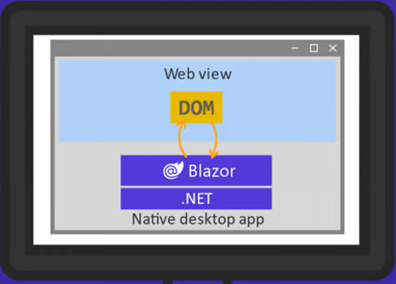
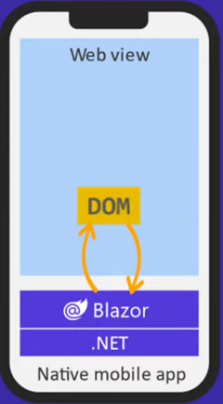
Blazor Hybrid for Desktop & Mobile

Slide 26
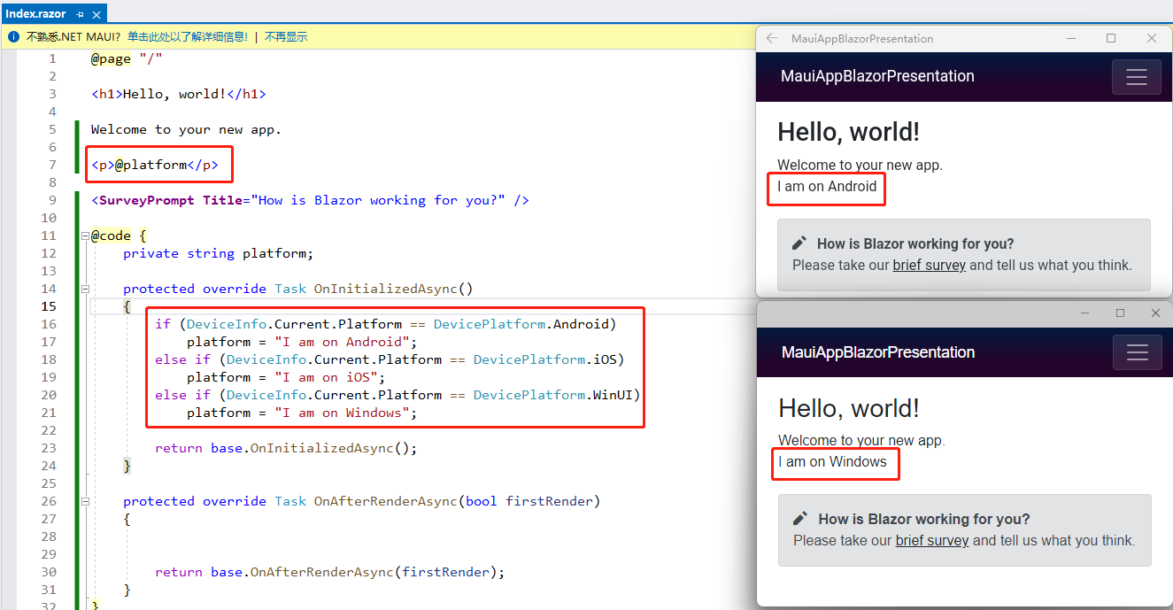
Same code on Different platforms with Blazor Hybrid

Slide 27
Superior Code Reusability
Web
Desktop / Mobile
Blazor
Client App
Blazor
Client App
.NET MAUI
ASP.NET Core
Razor
Class Library
.NET for
Android
.NET for
Mac
.NET
.NET for
iOS
WINUI 3

Slide 28
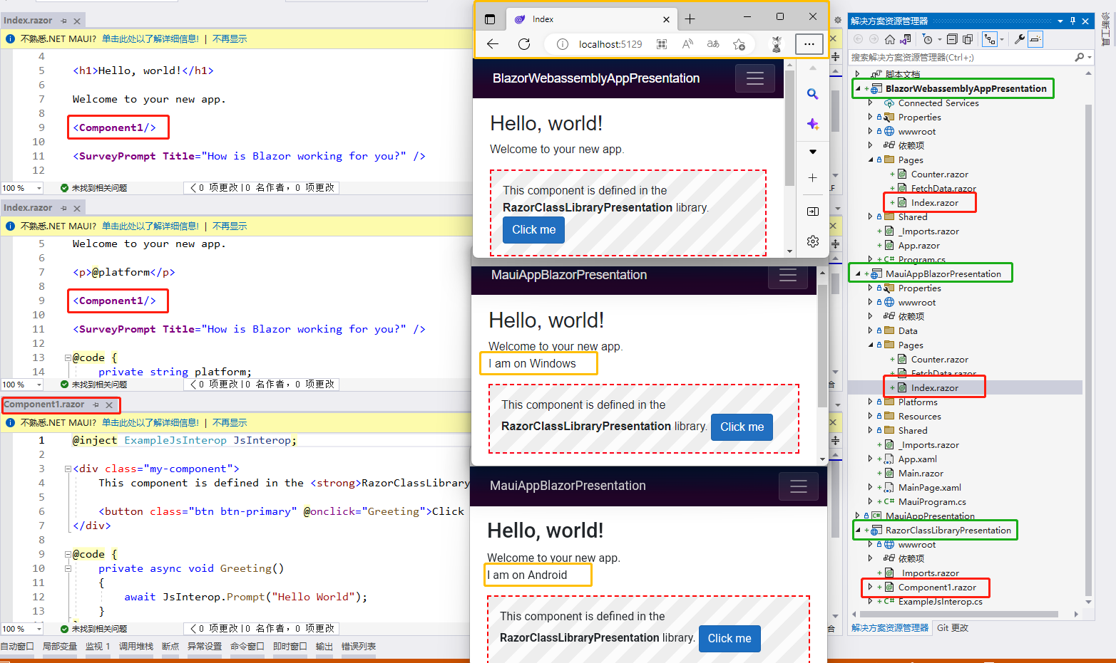
Share Codes with Web and App
razor library

Slide 29
What Are The Tradeoffs?
Native
Hybrid
Native UX
Better Performance
Hardware Integration
Reusable Code
Faster Development
Less Expensive

Slide 30


